Slide 1
Review & Validation of the remote CARI (rCARI)

Slide 2
Background
Methodologies to assess & report of acute food insecurity (AFI) abound
Acceptance & reliability depend on transparency, compatible, & comparability
IPC-Integrated Food Security Phase Classification & Cadre Harmonise (CH)
CARI – Consolidated Approach of Reporting food Insecurity
Recently the rCARI – Remote Consolidated Approach of Reporting food Insecurity
IPC used since 2004
Consensus based approach to classifying AFI-convergence of evidence
Led by experts in the field (TWG)
Notes:
The 5 IPC Phase classification of food insecurity
Phase 1 (None/Minimal)
Phase 2 (Stressed)
Phase 3 (Crisis)
Phase 4 (Emergency)
Phase 5 (Catastrophe/Famine)

Slide 3
Background
CARI used since 2012
Used in the absence of IPC or CH to report AFI
Relies on HH survey data (national representative assessment data
Onset of COVID-19 pandemic restricted the use of CARI & IPC use
Vacuum of data for AFI analysis
WFP developed the remote CARI (rCARI) to report AFI
Good for quick operational decisions
Relies on call centers or Computerized Assisted Telephone Interviews (CATI)
Notes:
Matrix of simple & easy to understand food security questions

Slide 4
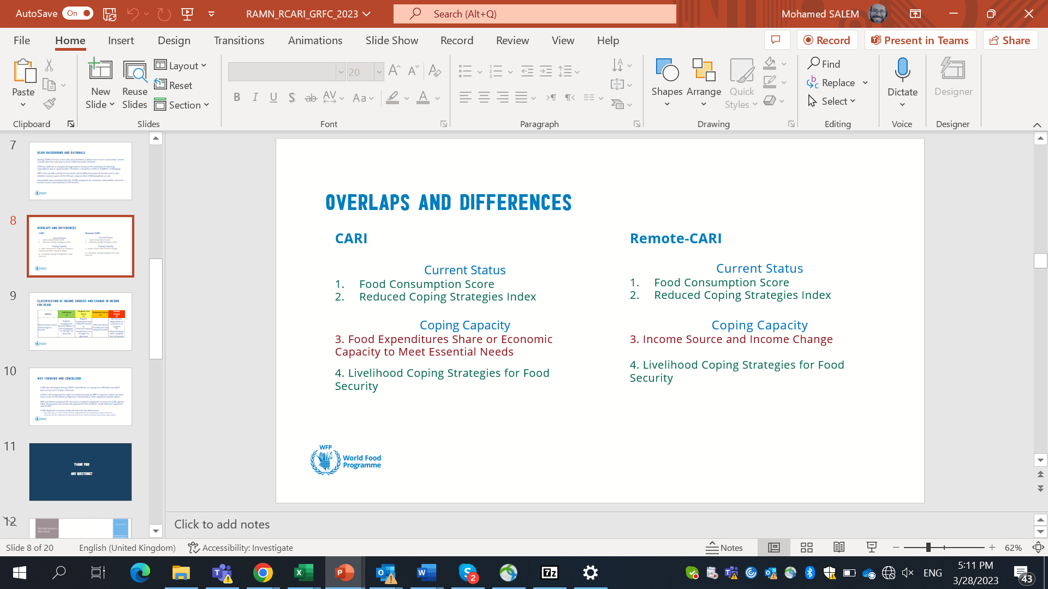
Background
CARI and rCARI aggregate indicators in a similar way (except on the economic vulnerability dimension)
To date, rCARI is not validated against the conventional CARI
Notes:
rCARI useful in emergencies where F2F survey is not feasible
The Challenge with rCARI numbers & methodology is that not it is been validated against CARI or IPC
Though is easily available, results are not globally accepted
rCARI is based on the following modules
Food consumption score
Consumption-based coping strategy (rCSI)
Livelihood coping strategy (usually a shorter version of the original)
Income sources
Changes in income

Slide 5
Main Objective
Compare the results of rCARI with standard CARI
Secondary objectives:
Compare & validate the different livelihood coping strategy modules – LCS Essential Needs, & LCS Food Security
Compare & validate the results of the rCARI with other standard food security measurements like IPC.
Notes:
Primary objective:
Compare the results of rCARI, i.e., remote CARI with standard CARI version 3. This will contribute to answering the question of comparability and convergence of the remote and face-to-face modules and methodologies for collecting food insecurity.
Secondary objectives:
Compare and validate the different livelihood coping strategy modules e.g., LCS-Essential Needs, LCS- Food Security.
Compare and validate the results of the rCARI with other standard food security measurements like IPC.

Slide 6
Methodology
Randomized Control (RCT) Design
Involves two comparable groups – (Face-to-Face & Remote)
Randomly assigned to the two groups
Face-Face (control) & Remote (treated)
Both interviews to run concurrently
Stratified sampling units/respondents
Min. 2 Admin1 or Livelihood Areas
4 Admin2 Areas
20 Admin3 Areas
35 HH per Admin3 Area

Slide 7
RCT Design Setup
Group A (Phone)
750 HH
Sampled HH
1200 + (xx% none response)
Group B (F2F)
750 HH

Slide 8
RCT Design Setup
Group A (Phone)
750 HH
Sampled HH
1200 + (xx% none response)
Group B (F2F) 750
375 HH Long-modules
375 HH Short Modules

Slide 9
Modules
Quantitative data will be collected
Face-to-Face
Remote interviews
Quantitative modules
Food consumption
Livelihood coping strategy
Consumption based
Essential needs
Food expenditure score
Income sources
Changes in income

Slide 10
Tentative workplan
Time Activity | May 2023 |  | June 2023
 | W1 | W2 | W3 | W4 | W5 | W6
Adapting the Questionnaire to CAR
2. Compiling list of households with contacts
3. Training of Enumerators
4. Testing of Questionnaire
5. Data Collection
6. Final Dataset & Report

Slide 11
Thank you

